Slide 1


Ahsanullah University of Science and Technology
Department of Computer Science & Engineering
Course No : 1108
Course Title : Introduction to Computer Systems
Assignment No : 05
Assignment Name : PowerPoint Presentation
Date of Submission : 23-02-2021
Submitted to : Mr. A.K.M. Amanat Ullah,
Lecturer, AUST
&
Mr. Mir Tafseer Nayeem,
Assistant Professor, AUST
Submitted by : Md. Shaikat Ahmed ( 200104124 )
Arman Hasan Mahy ( 200104110 )
Shuvashis Sarker Shuvo ( 200104116 )
Mohammad Rabbu ( 200104109 )
Shamim Rahim Refat ( 200104125 )

Slide 2
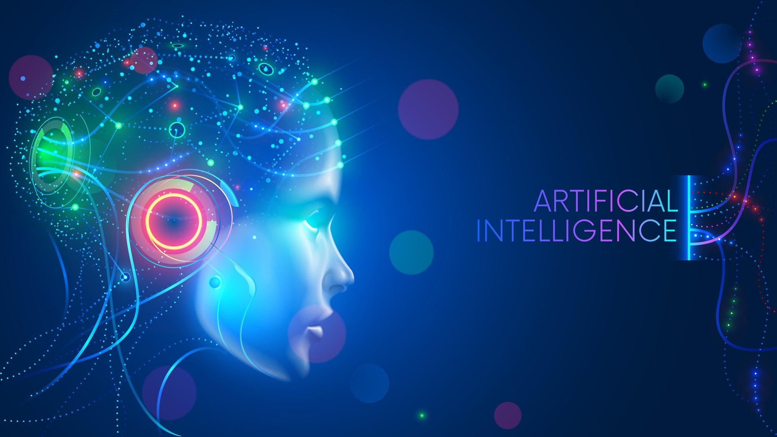
1

Slide 3
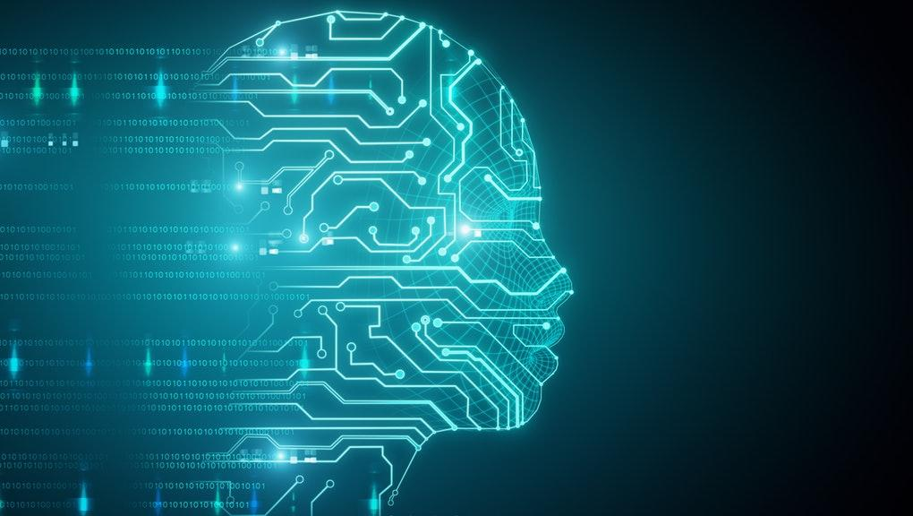
CONTENTS :
Definition
Early History
Types of AI
Current status of AI
Challenges for AI
Subset of AI
Future of AI
Pros & Cons
Conclusion
2

Slide 4
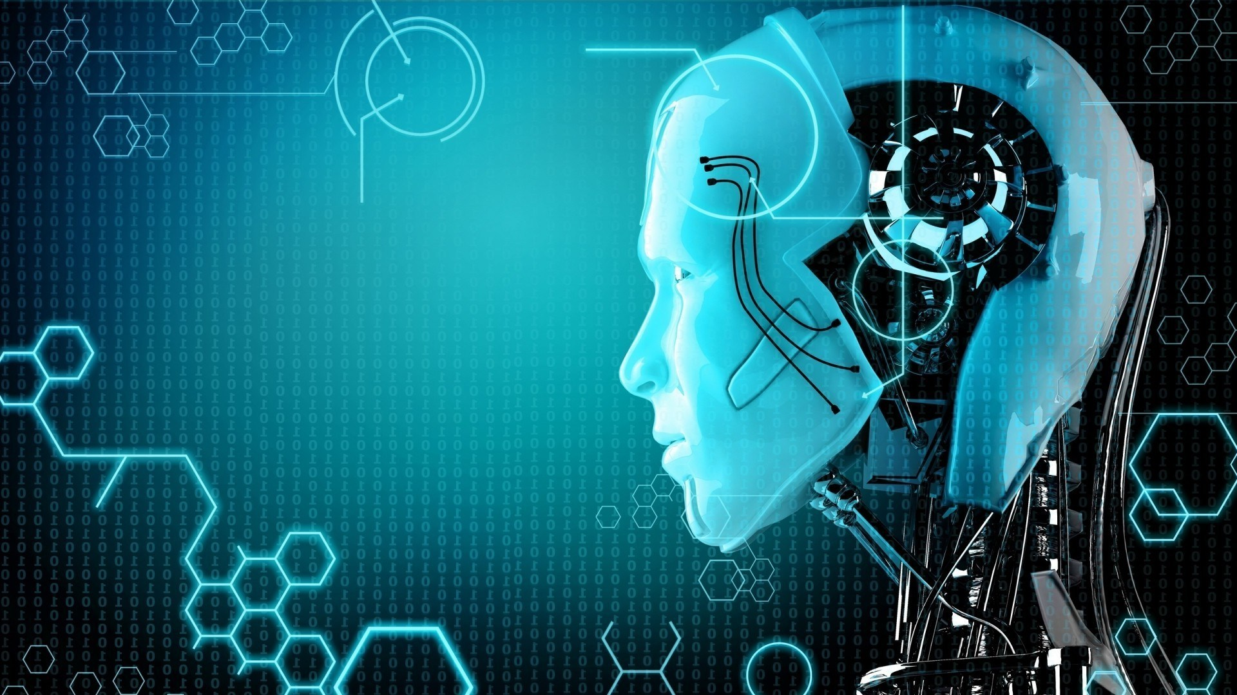
What does Artificial
Intelligence (AI) mean?
3

Slide 5
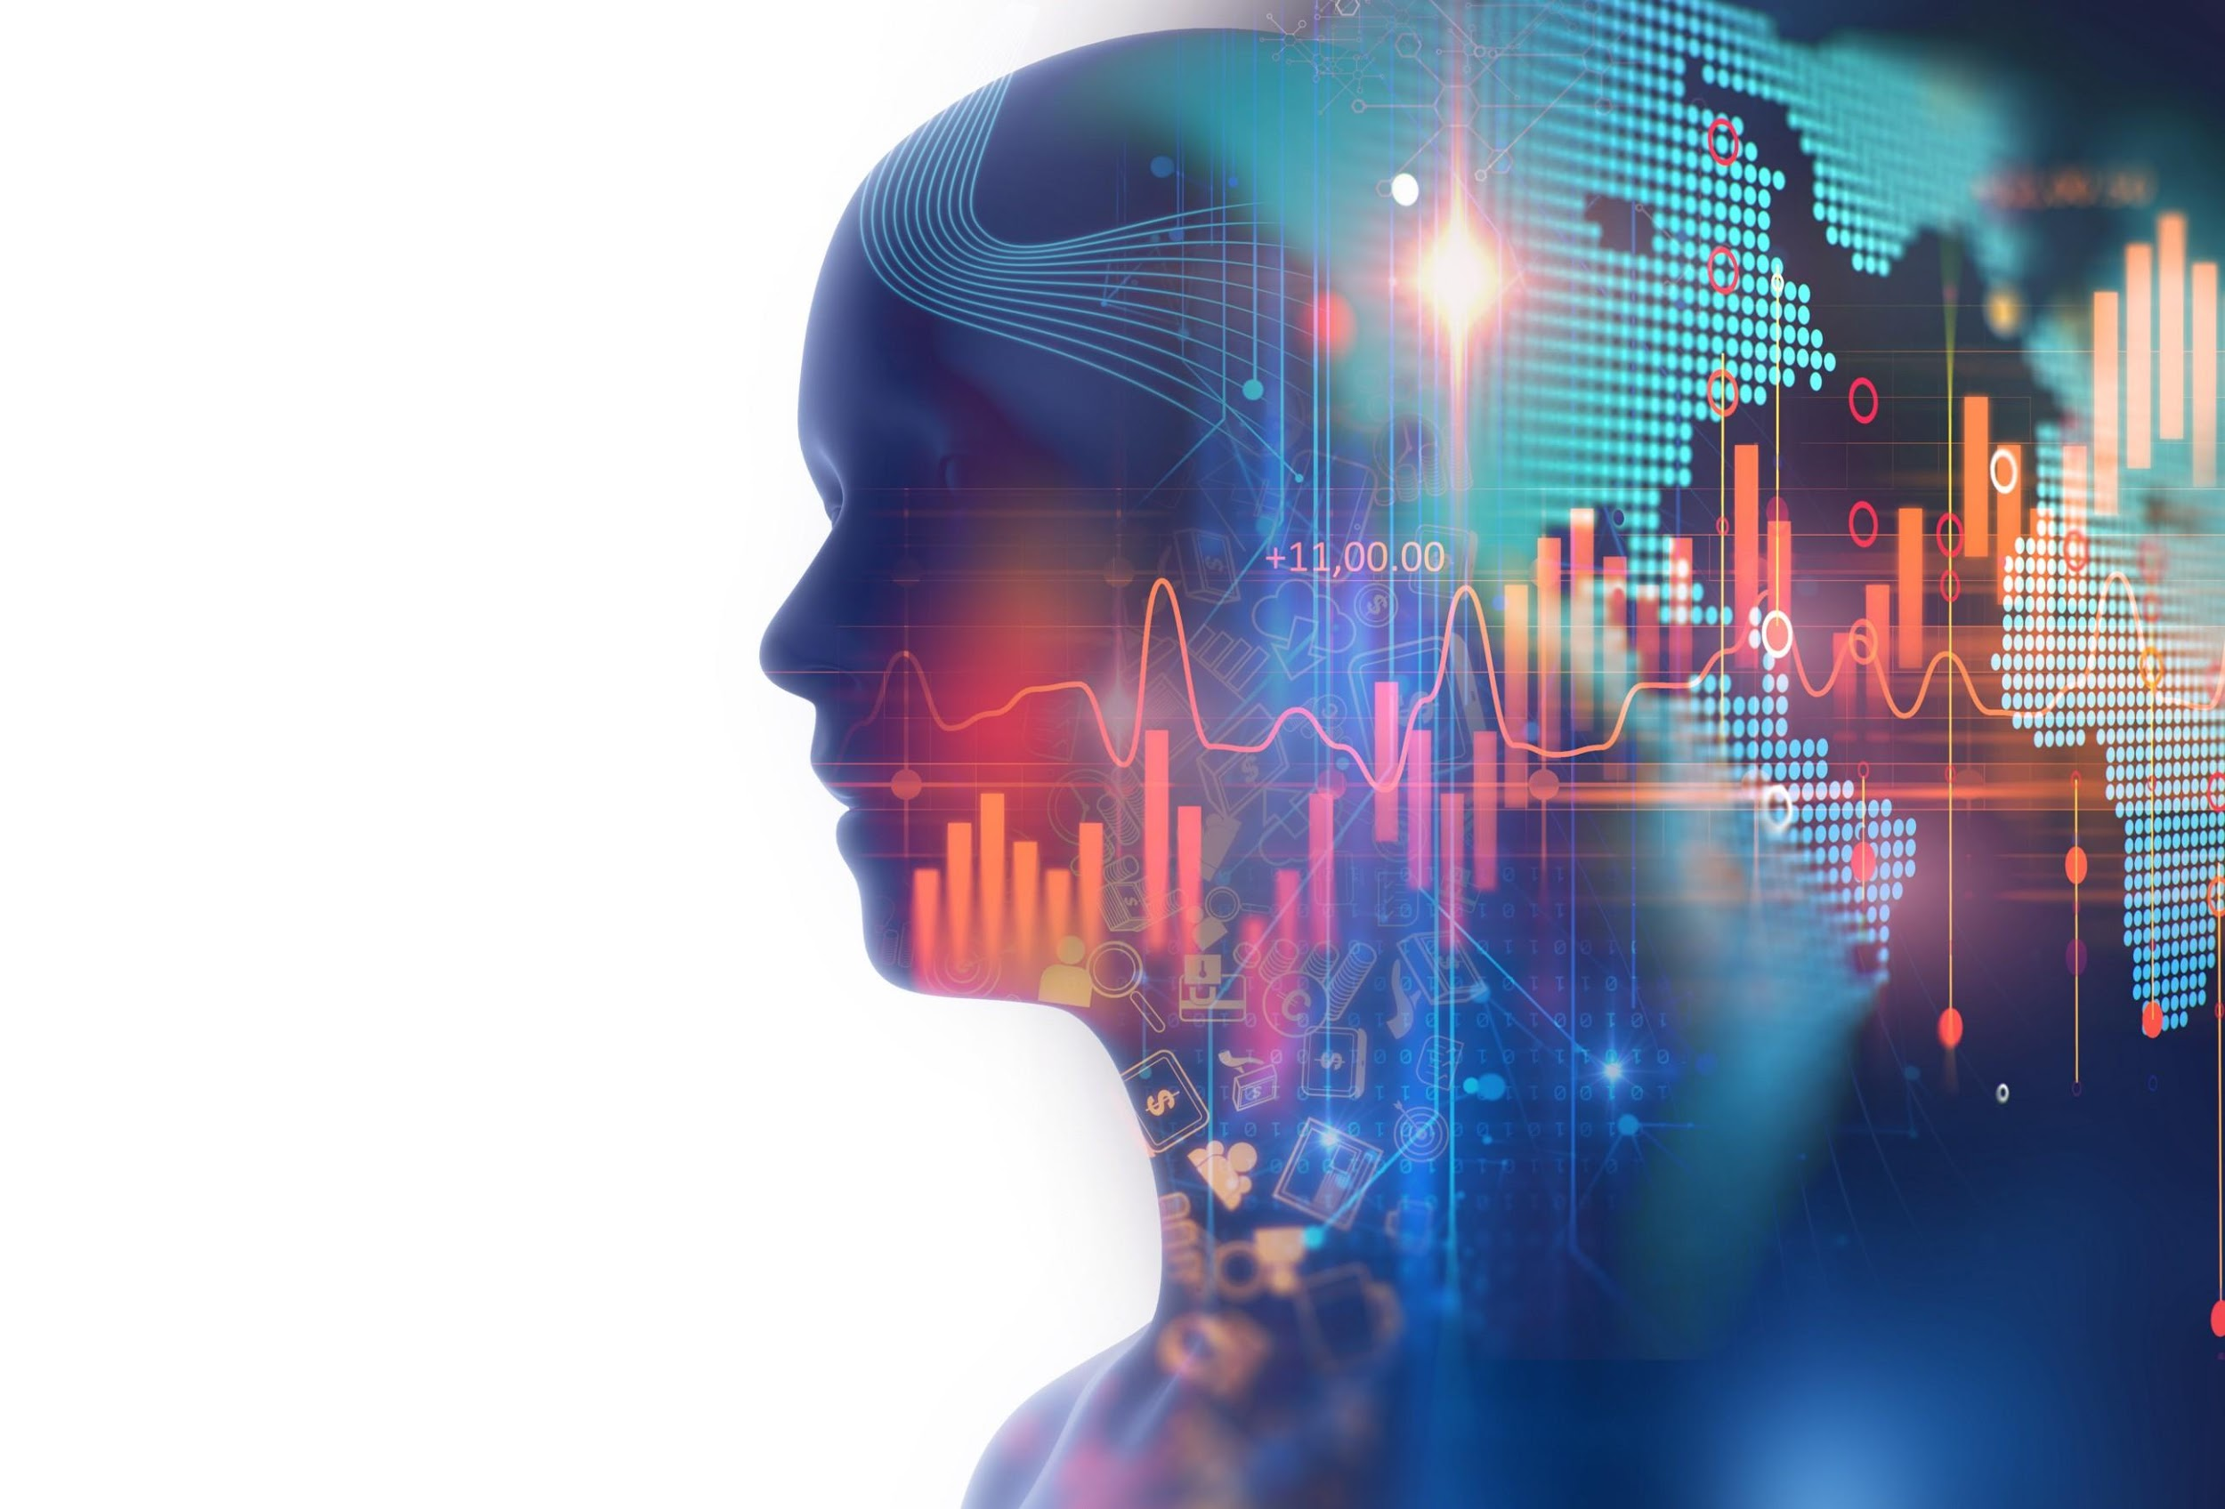
Artificial Intelligence (AI) is an area of computer science that emphasizes the creation of intelligent machines that work and react like humans. Some of the activities computers with artificial intelligence are designed for include:
Speech recognition
Learning
Planning
Problem solving
4

Slide 6
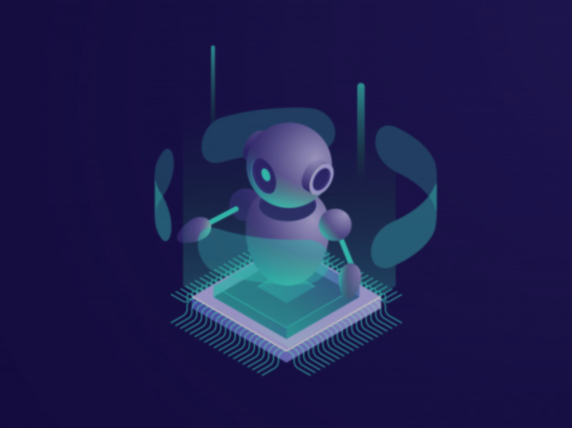
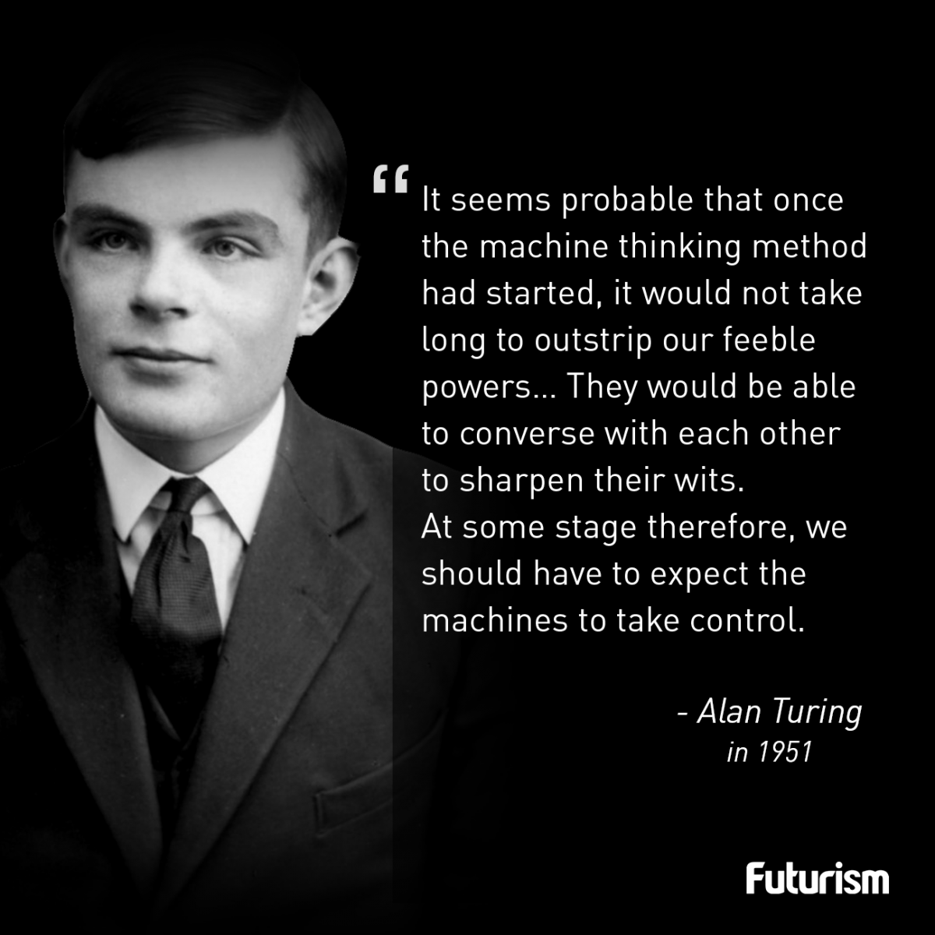
Early History
Of Artificial Intelligence
5

Slide 7
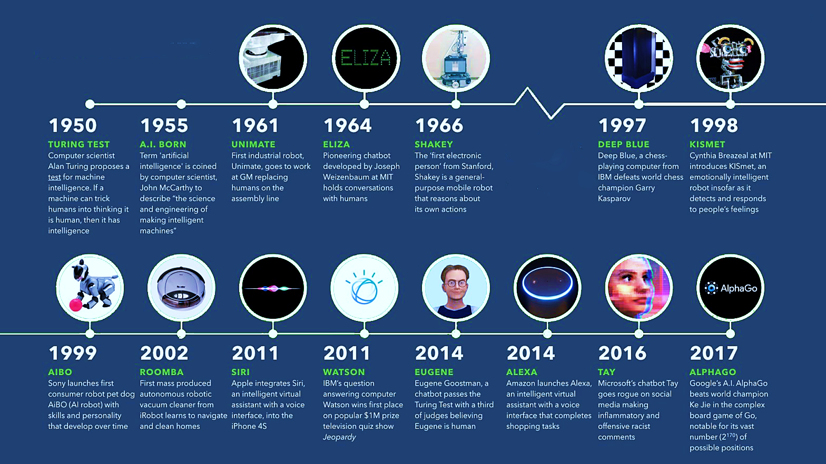
History of
Artificial Intelligence
6

Slide 8

The Electrifying
History of
Artificial Intelligence
1964
An IBM program invented that understood language
2011
Introduction of SIRI and Google Assistance
The A.I was first discovered during
World War ll has since tremendously
Improved over the years.
1955
First self-learning games was invented
1999
Sony created AIBO an A.I robot dog

Slide 9
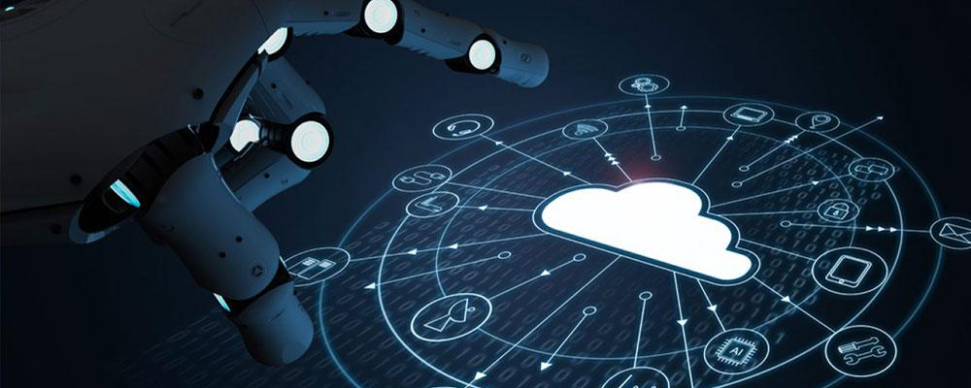
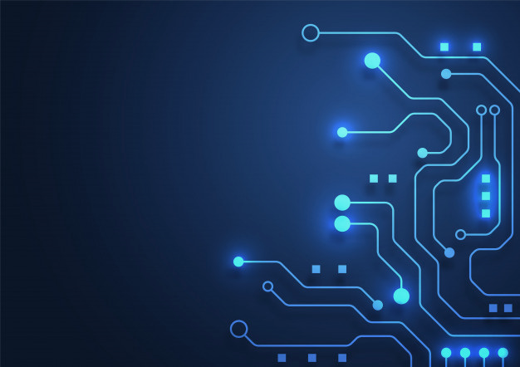

CURRENT STATUS OF AI :
AI has taken many shapes and forms over the recent years-
Mobile Phone (Siri/Cortana)
GPS
Voice recognition
Robotics
Deep learning is a machine learning based on algorithms.
8

Slide 10
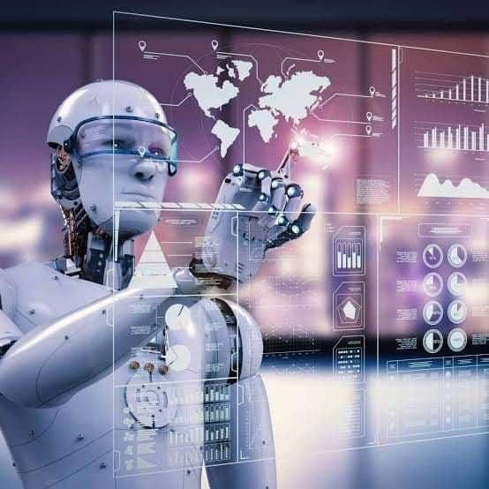
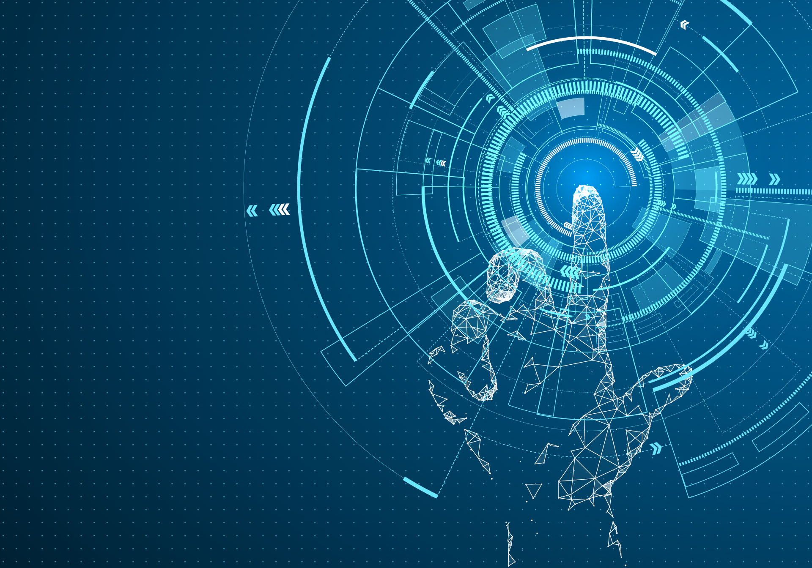
CHALLENGES
Computing Power
Knowledge
Data & Bias
Data Security
9

Slide 11
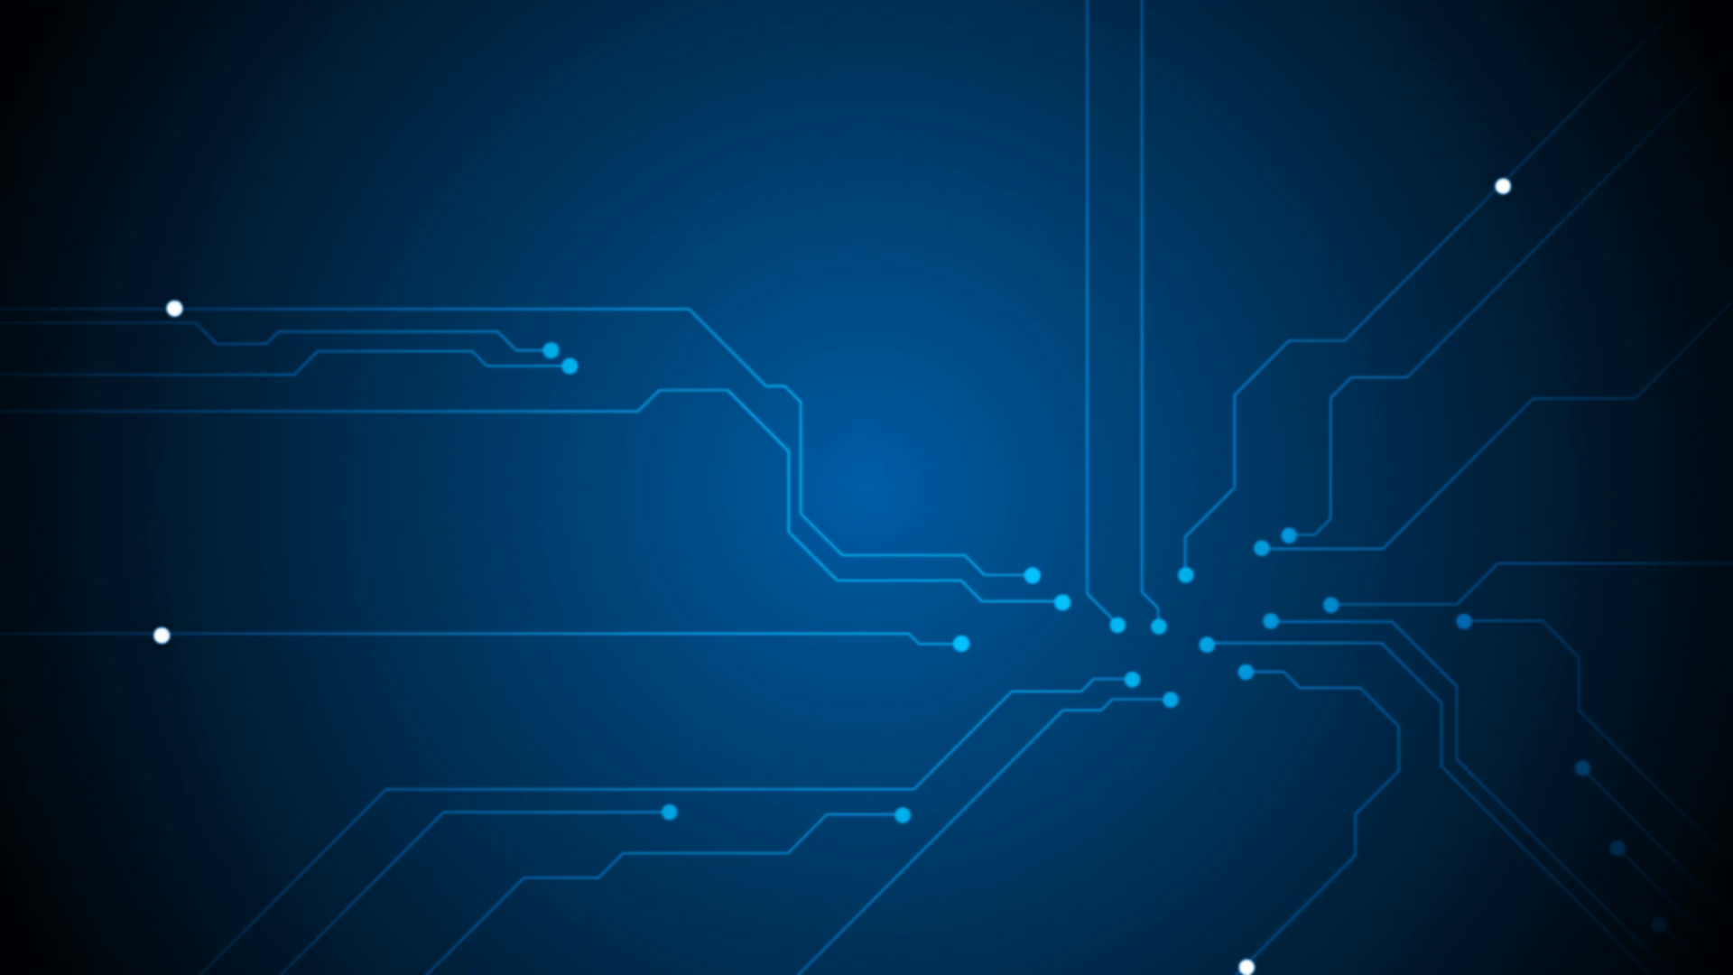
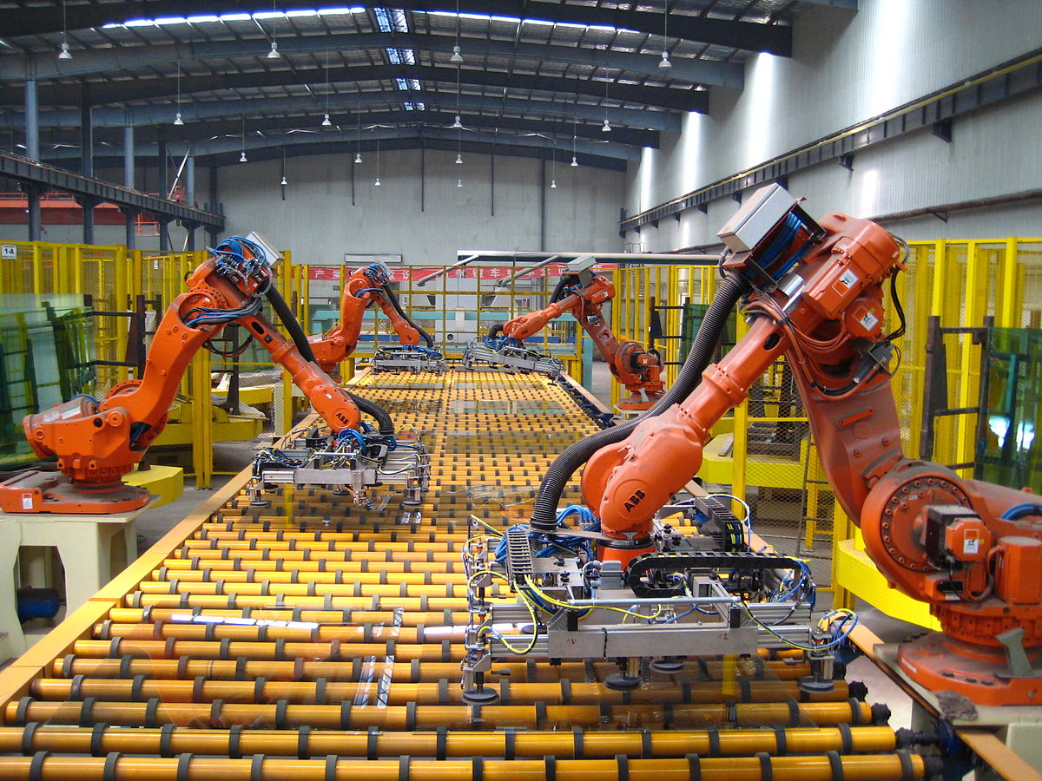
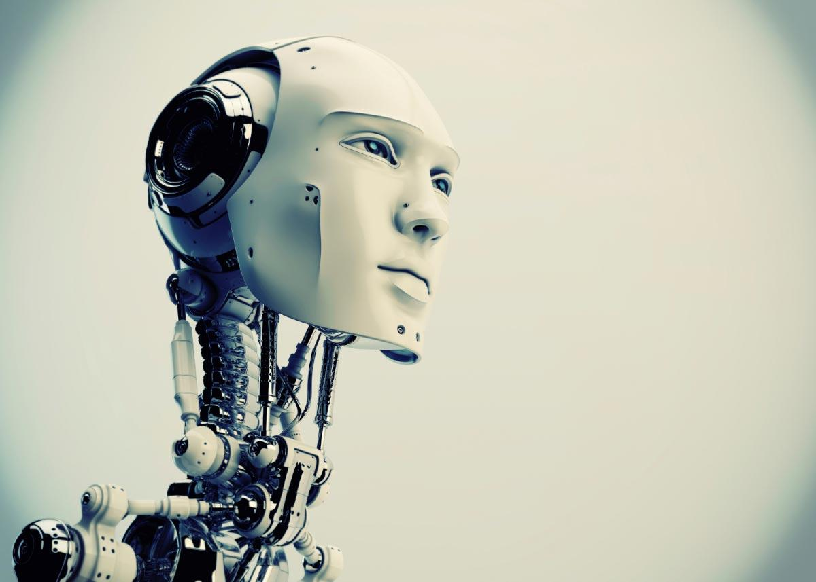
Weak AI :
Machines with weak Artificial Intelligence are made to respond to specific situations, but can not think for themselves
Strong AI :
A machine with strong A.I. is able to think and act just like a human. It is able to learn from experiences.
Since there are no real life examples of strong A.I. yet, the best representation would be how Hollywood portrays robots
10

Slide 12

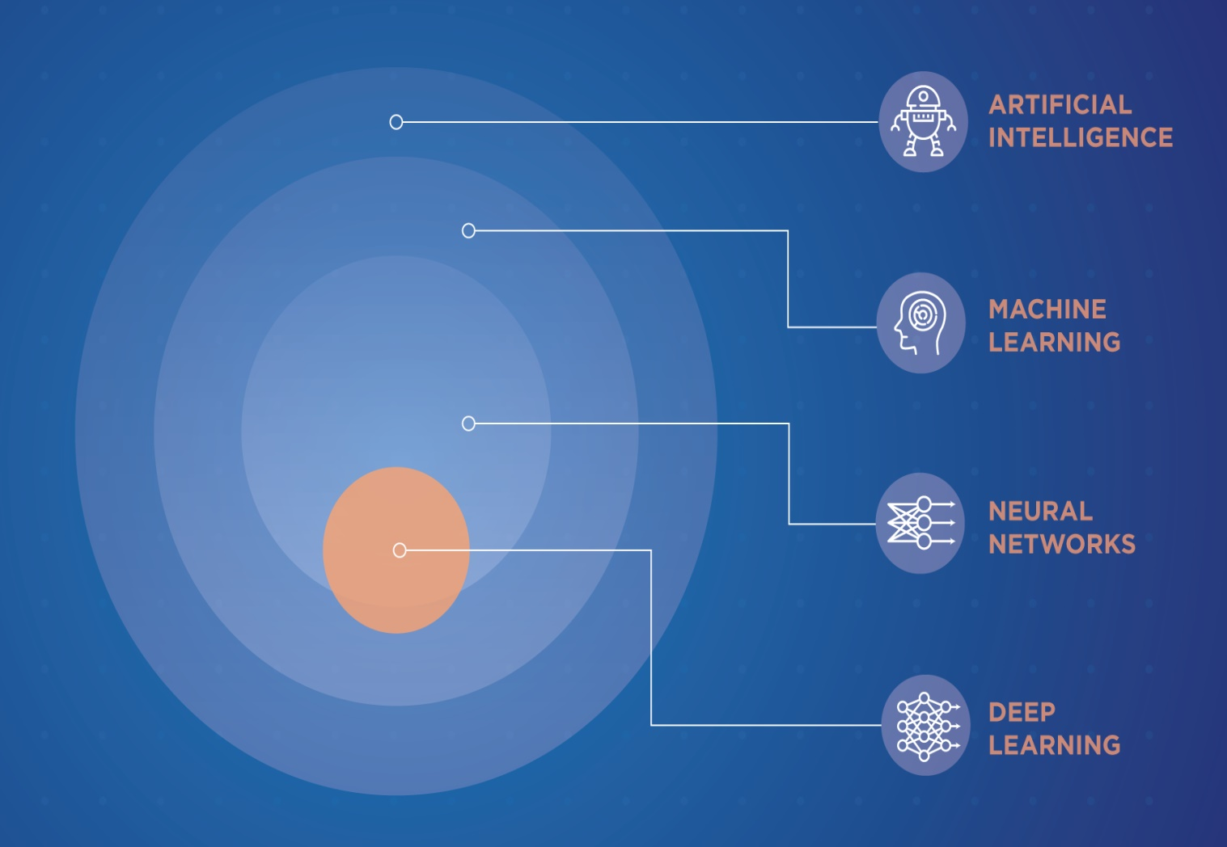
Sub-set of Artificial Intelligence
Machine Learning
Machine Learning is creating a function that mimics the patterns in data.
Neural Network
It is made up of layers, where each layer is densely connected to the next layer.
Deep Learning
It’s any Artificial Neural Network that has more than one layer. It’s been proven that any function that can be modeled by multiple layers can also be modeled by a single layer; however, in practice deep learning often results in better results with less nodes, faster.
11

Slide 13

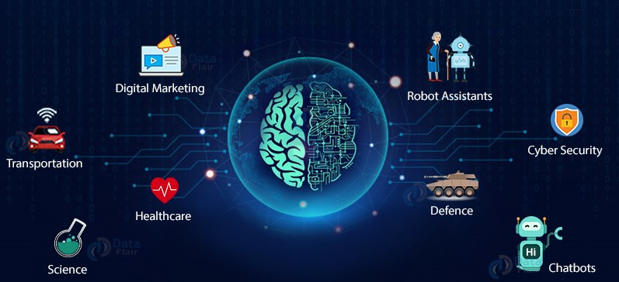
The Future of AI
Cyber Security
Face Recognition
Data Analysis
Medical sector
Defense and Wars
Transport
Emotion bots
Marketing and Advertising
Soaring demand of AI professionals
12

Slide 14

Pros and Cons of Artificial Intelligence A Threat or a Blessing?
Pros :
Reduction in Human Error.
Takes Risks Instead of Humans.
Available 24x7.
Helping in Repetitive Jobs.
Digital Assistance.
Faster Decisions.
Daily Applications.
New Inventions.
13

Slide 15

Cons:
High Costs of Creation.
Making Human Lazy.
Unemployment.
No Emotions.
Lacking Out of Box Thinking
14

Slide 16
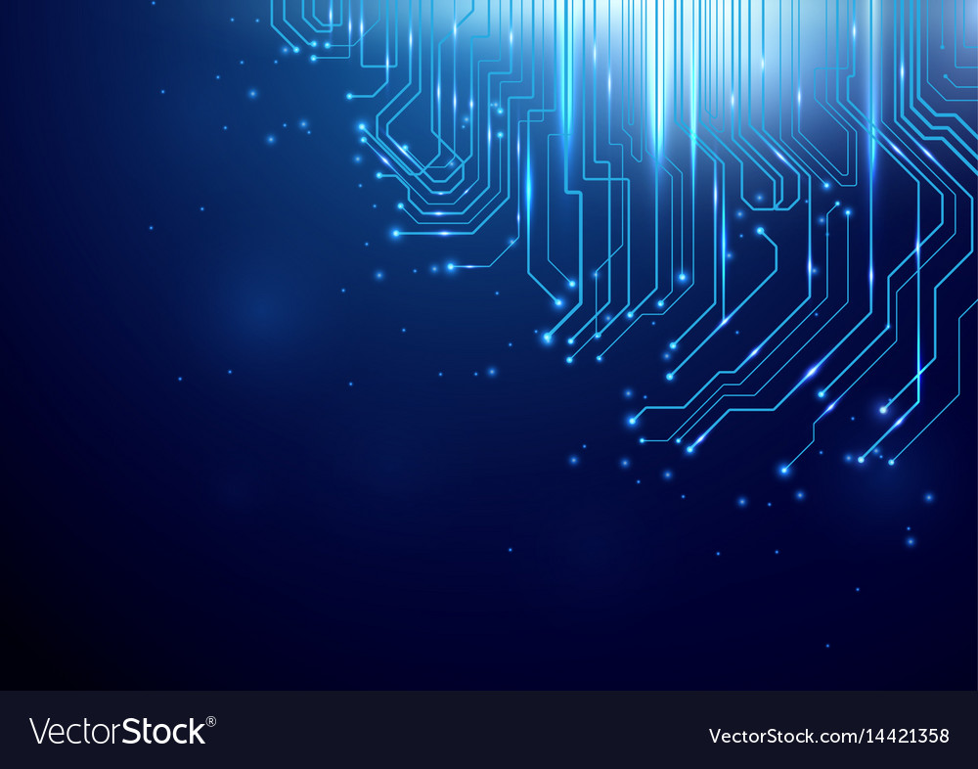
Conclusion
All being said, the pros and cons of artificial intelligence being evaluated, it is up to the reader, user, and their perspective.
AI and robotics will improve the way we think, the way we explore new horizons, whether space or the ocean.
Human beings know what they need and are getting increasingly better in defining their wants and quickly transforming this into reality.
In the near future, things will happen so rapidly that we will see major changes and innovation.
Source : Google, YouTube, Wikipedia, Reddit, Quora, etc.
15

Slide 17

THANK YOU!

